Slide 1
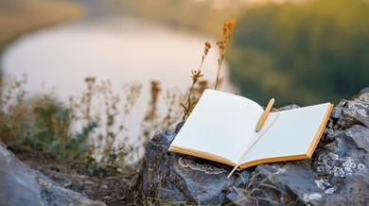

Competition 2
Creative Writing Competition

Slide 2
Would your pupils like to showcase their creative writing and celebrate the beautiful landscapes around their school?

Slide 3
We are opening our second competition of the year – our Creative Writing competition!
It is open to all year groups!

Slide 4

The Rules

Slide 5
1
Entries must be a piece of creative descriptive writing inspired by a landscape, place of beauty, or natural feature near your school.

Slide 6
2
The piece should be no more than 200 words in length

Slide 7
3
Try to use vivid vocabulary and descriptive techniques to bring your chosen location to life for the reader.
Think carefully about what you can see, hear, smell, feel, and even taste in your chosen location. Great descriptive writers help readers imagine they are there themselves!

Slide 8
4
You may include a photograph or a drawing of your chosen landscape to accompany your writing, although this is optional.
The creative writing itself will remain the primary focus of the judging.

Slide 9
5
Each school should select its own winning entries
Primaries - one each from EYFS/KS1/KS2
Secondaries - one each from KS3 and KS4)

Slide 10
6
The closing date for entries is Tuesday 10th November 2026

Slide 11
7
You must include your name, school, and year group on the entry

Slide 12
8
Individual school winners will be collated and forwarded for final judging by a panel comprising representatives from the Trust
There will be 5 overall Champions selected

Slide 13
9
Entries will be judged on:
Creativity and originality
Use of descriptive language
Ability to create a vivid sense of place
Technical accuracy appropriate to age and stage
Overall impact on the reader

Slide 14
10
Winning entries will be published on the TrustEd Schools website, Trust communications, and individual school websites/socials.
Any accompanying photographs or artwork may also be displayed along with your first name, year group and school

Slide 15
We really look forward to seeing what you can produce!!!

Slide 16
For more information – see
Miss Roberts

