Slide 1

TrustEd Schools
proudly present…

Slide 2

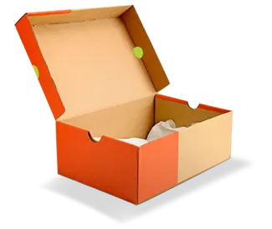
Science in a shoebox competition

Slide 3

Science in a shoebox
Would your pupils like to showcase their scientific creativity and innovation?
Enter our Trust Science competition and see their work displayed at our Science fair!

Slide 4

The Rules

Slide 5
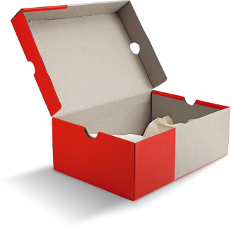

1
The competition is open to all pupils from EYFS to KS4, at all skill levels.

Slide 6
2
Pupils should create a science project or experiment presented in a shoebox

Slide 7
3
This could include:
• A working model or demonstration
• An experiment with results displayed
• A scientific concept explained through a creative display
• An invention or innovation

Slide 8
4
Each school can enter up to 2 entries per Key Stage (EYFS, KS1, KS2, KS3 and KS4)

Slide 9
5
All entries will be displayed at Stokesay Primary School on Friday 1st May from 1-2pm

Slide 10
6
Entries will be judged by a panel comprising representatives from the Trust

Slide 11
7
Judging criteria will include:
- Scientific accuracy and understanding
- Creativity and presentation
- Clarity of explanation

Slide 12
8
As a condition of entry, pupils agree to grant the TrustEd Schools license to reproduce the design on our website.

Slide 13
9
For more information – see
XXXXXXXXX

